Slide 1
CAPSTONE PROJECT Weather Analysis
- JHANSI GUNJA

Slide 2
THE MAIN PROBLEM STATEMENT
Analyse weather trends, seasonal variations, and correlations between weather attributes. Use Excel and SQL to gain insights and their impact. Develop a Power BI dashboard for weather monitoring and historical weather analysis.

Slide 3
OBJECTIVE
The main objective of this project is to uncover the relationships among weather attributes, Understanding the weather descriptions, exploring the seasonal variations and comprehend the influences of geography.
ANALYSIS AND SCOPE
The weather analysis spans a wide spectrum, exploring various facets of meteorology. It extends globally, scrutinizing climate patterns, and thoroughly examining weather conditions. Moreover, the scope encompasses a detailed analysis of different meteorological phenomena.
GOAL
The primary goal is to offer comprehensive insights into the dynamics of weather attributes, facilitating a understanding of their patterns and trends observed over the years in weather analysis.

Slide 4
INSIGHTS AND RECOMMENDATIONS
The thorough examination conducted through the Power BI dashboard in weather analysis will generate valuable insights into meteorological patterns, emphasizing trends in climatic conditions over time. It will evaluate the performance of diverse weather phenomena.
REPORT AND PRESENTATION
The final deliverable will consist of a detailed presentation describing the data sources, data modelling methodologies, and data cleansing processes used in creating the Power BI dashboard.
DASHBOARD
The Final Dashboard will consist of the things as per the requirement and it will help us to understand the detailed information of every aspect of the Weather considering all the factors.

Slide 5
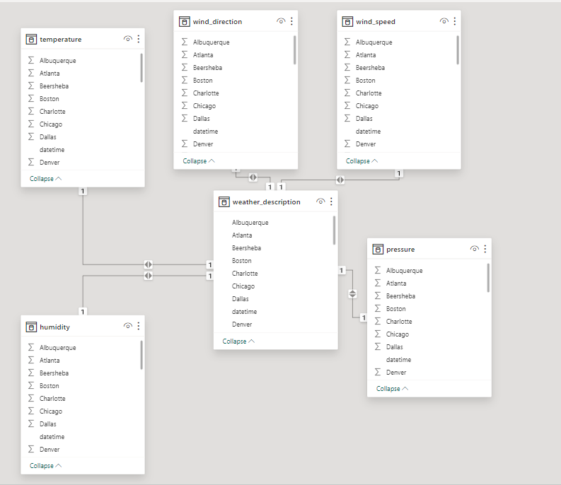
ER Diagram

Slide 6
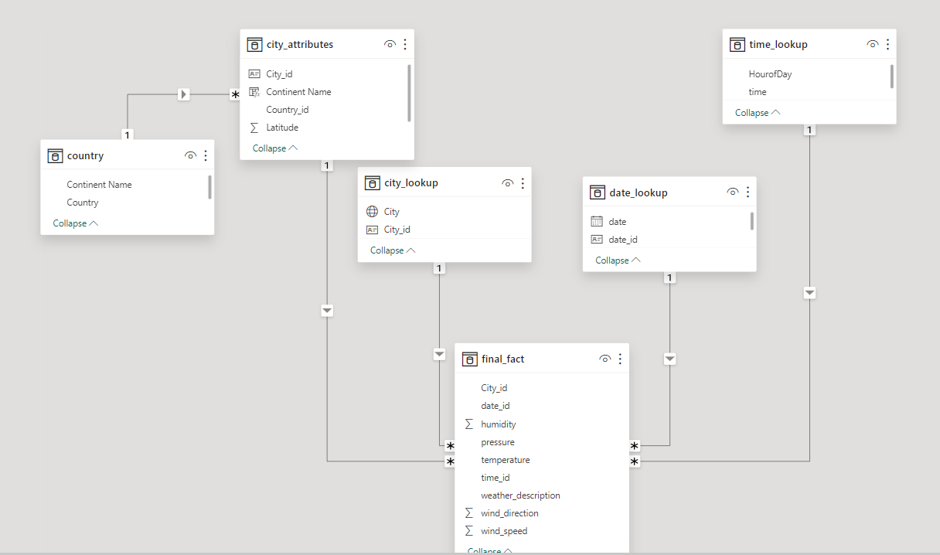
ER Diagram (Changed as per the Requirement)

Slide 7
POWER BI
PROBLEM
STATEMENTS

Slide 8
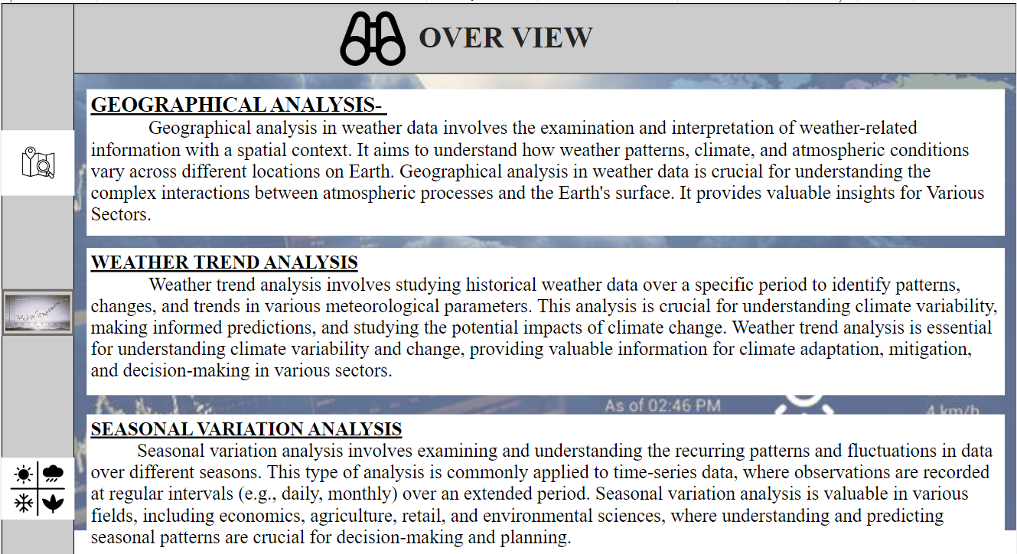
WEATHER ANALYSIS IS THE COMBINATION OF GEOGRAPHICAL ANALYSIS, WEATHER TREND ANALYSIS AND SEASONAL VARIATION ANALYSIS

Slide 9
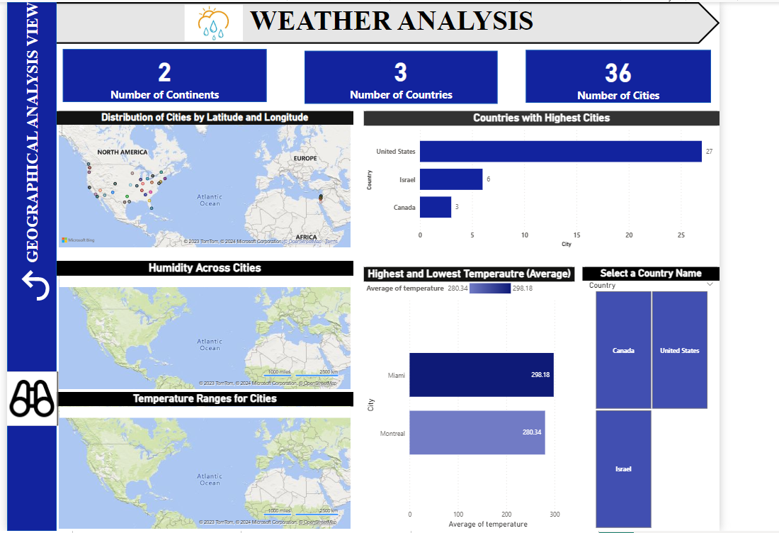
GEOGRAPHICAL ANALYSIS VIEW

Slide 10
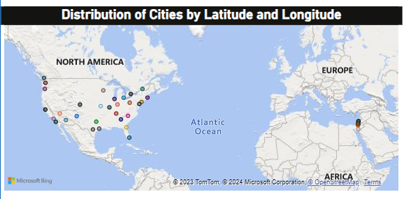
PROBLEM STATEMENT
Can you create a geographical map in Power BI showing the distribution of cities in the dataset based on their latitude and longitude? (Q-1)
EXPLANATION
The above Map Visual represents the Distribution of Cities based on the Latitude and Longitude. The each Colour represents each city in the Map Visual. To know about the city name, we can make it clear in Power BI by placing the cursor over the colour and it will showcase us the city name, latitude and longitude.

Slide 11
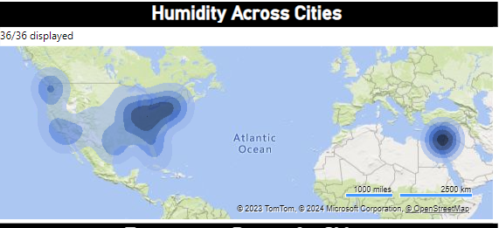
PROBLEM STATEMENT
How does humidity vary across different cities? Generate a heatmap in Power BI to visualize this variation. (Q-5)
EXPLANATION
The above visual is the Heat Map, showing the Humidity across different Cities. The humidity data we have is for every hour and there can be vary difference in the Humidity across over the Cities. Here the Variation can be seen clearly by zoom on the Visual in Power Bi, which Provides us the more Insights.

Slide 12
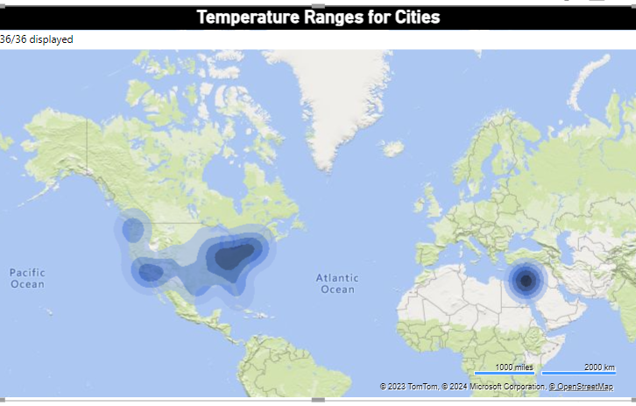
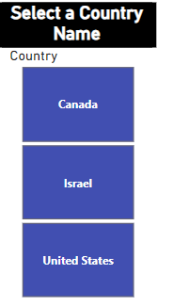
PROBLEM STATEMENT
Can you build a heatmap in Power BI to show the temperature ranges for cities across different countries? (Q-11)
EXPLANATION
The above is the Heatmap Visual, showing us the temperature ranges for the cities across different Countries. The each country wise can be see with the help of Slicer, possible in Power BI only.
Country Name Slicer

Slide 13
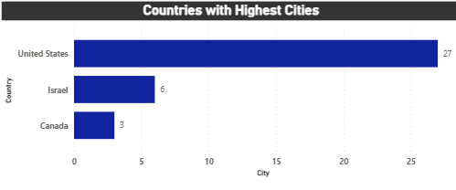
PROBLEM STATEMENT
In Power BI, can you create a bar chart representing the top 10 countries with the highest number of cities in the dataset? (Q-2)
EXPLANATION
The above chart represent the bar chart with Countries along with their number of Cities. The actual question is to find the top 10 Countries with highest number of Cities, but as per the data there are only 3 Countries over there. So, with that we can not find top 10 from 3. So, it represents the Number of Cities in Descending Order from each Country.

Slide 14
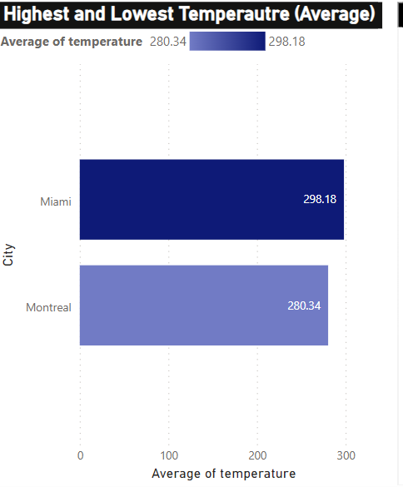
PROBLEM STATEMENT
Create a bar chart in Power BI to highlight cities with the highest and lowest average temperatures in the dataset. (Q-12)
EXPLANATION
Here, the bar chart visual us the highest and lowest average temperature from all over the Cities present in the given data. We made the average of all the cities and highlighted the Miami with 298.18 (Highest) Average of temperature and Montreal with 280.34 (Lowest).

Slide 15
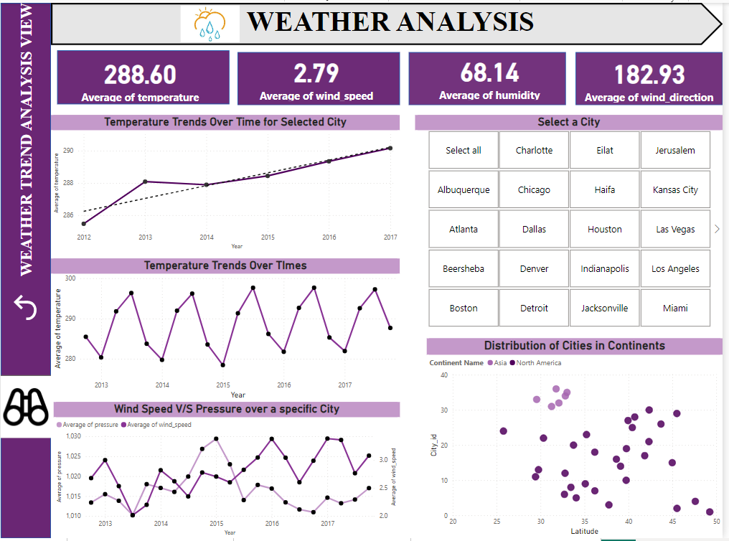
WEATHER TREND ANALYSIS VIEW

Slide 16
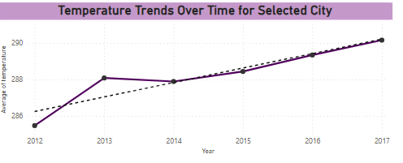
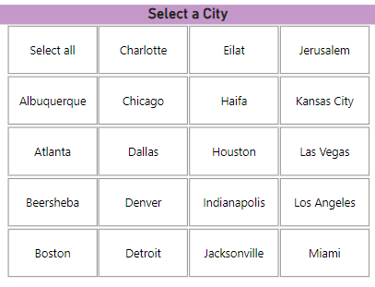
PROBLEM STATEMENT
Create a line chart in Power BI to display the temperature trends over time for a selected city. Highlight extreme temperature events? (Q-4)
EXPLANATION
The Above line chart represents the Average Temperature trends over the time. The dotted line represents the trend line which will help us to understand the direction of trend over time. The extreme temperature points has been highlighted with black dotes. To understand the trend for each city, can be possible in Power Bi with the help of a Slicer of City.
Slicer for City

Slide 17
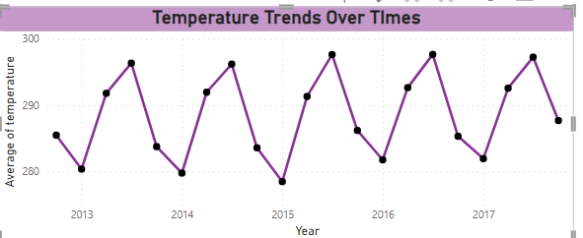
PROBLEM STATEMENT
Create a time-series line chart in Power BI to show the overall temperature trends over the entire dataset? (Q-7)
EXPLANATION
The above time series line chart is been showing us the overall temperature of the entire dataset. There is pattern been followed up every Year. The trend is been moving in the wave direction. Like in the beginning of the year the temperature is below 280 and gradually increasing up to 290 above in the middle of the year and again starts decreasing to the end of the year. Its been happening every Year (Mostly the Same Trend.)

Slide 18
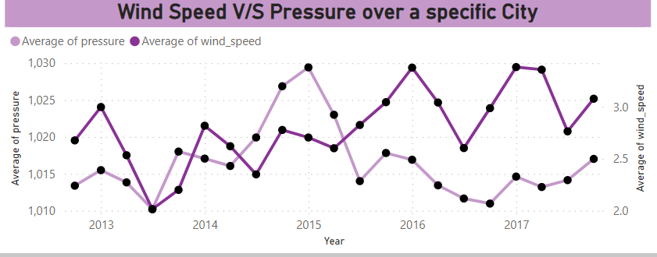
PROBLEM STATEMENT
Can you create a time-series chart in Power BI showing the relationship between wind speed and air pressure for a specific city? (Q-6)
EXPLANATION
The relationship between wind speed and Pressure over a time can be positive relation which means, the larger the wind speed the larger the pressure. Strong winds are accompanied by high pressure causing storm-like situations. To know the relation between air pressure and wind speed for each City, use of Slicer will make more Understandable.
Slicer for City

Slide 19
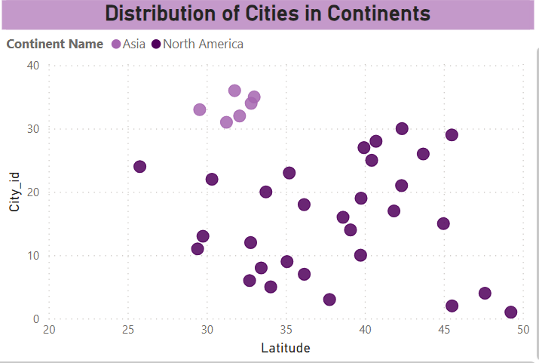
PROBLEM STATEMENT
How does the distribution of cities in terms of latitude vary across different continents? Create a scatter plot in Power BI to illustrate this? (Q-3)
EXPLANATION
The above scatter plot shows the Distribution of Cities in terms of latitude across different Continents can be seen, the darker shade represents the North America Continent and the lighter shade of the colour represents the Asia Continent. The latitude can be vary for each city.

Slide 20
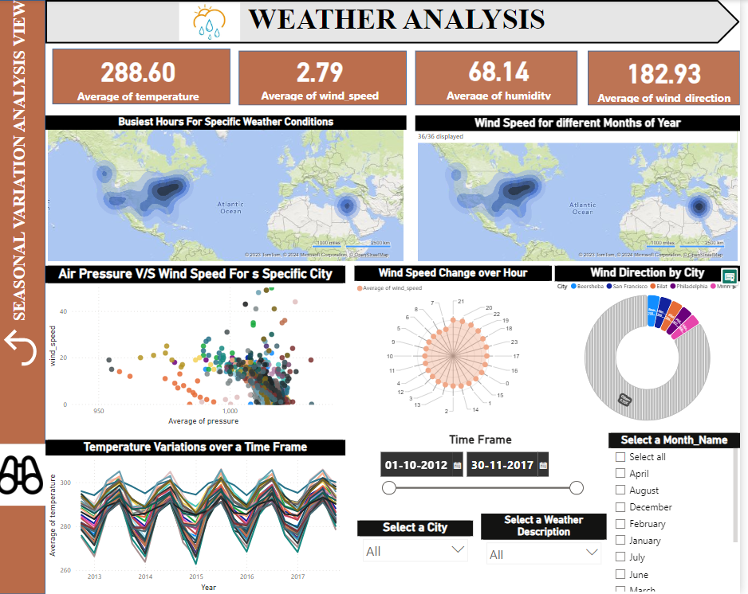
SEASONAL VARIATION ANALYSIS VIEW

Slide 21
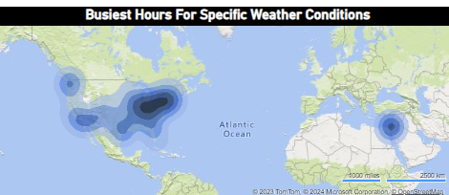
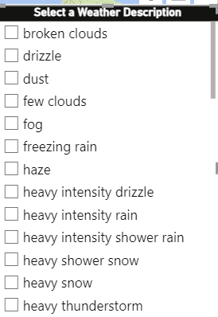
PROBLEM STATEMENT
Can you create a heatmap in Power BI to visualize the busiest hours for specific weather conditions (e.g., "clear sky," "rainy")? (Q-8)
EXPLANATION
The above visual is Heat Map which is been representing us the Business Hours for the Weather Conditions, to know about the specific weather condition we can made a use of the weather conditions slicer, make more meaningful and understandable.
Weather Description Slicer

Slide 22
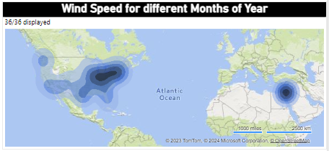
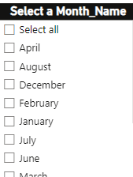
PROBLEM STATEMENT
Can you generate a Power BI heatmap illustrating the average wind speeds across cities for different months of the year? (Q-14)
EXPLANATION
The above visual is Heat Map which is been representing us the wind speed for different months of Year. To know about the specific Month condition we can made a use of the Month of the Year slicer, helps to find out the more meaningful insights.
Month of the Year Slicer

Slide 23
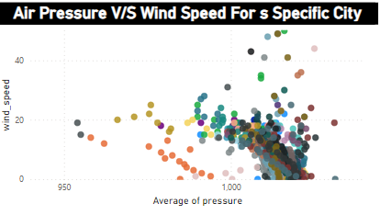
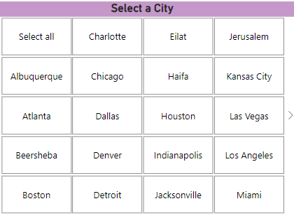
PROBLEM STATEMENT
Create a Power BI scatter plot to show the relationship between wind speed and air pressure for a specific city? (Q-15)
EXPLANATION
the above chart shows the relationship between the average of both the wind speed and pressure. Actually the chart shows the relationship among all the cities, to know about a specific City, its better to make use of the slicer for City in Power BI. In General, there will be a positive relation
among those attributes.
City Name Slicer

Slide 24
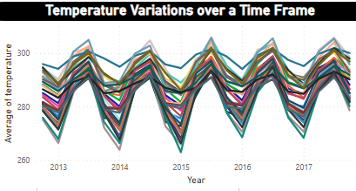

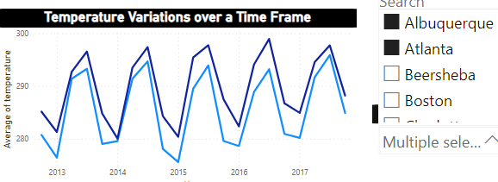
PROBLEM STATEMENT
Create a Power BI chart comparing the temperature variations between two selected cities over a specific timeframe? (Q-10)
EXPLANATION
the Above chart is the time series chart (Line chart). The line chart showing us the varaitions of temperature for all the cities. But the actual question is to showcase between two selected cities. To make is possible we need to use the slicer of City name by selecting 2 Cities at a time
City Name Slicer
Example-

Slide 25
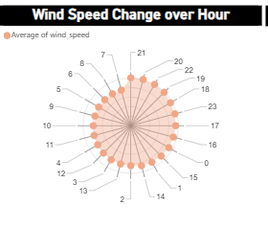
PROBLEM STATEMENT
How does the wind speed change over the course of a day? Create a radial chart in Power BI to represent this? (Q-9)
EXPLANATION
The Above Chart represents the wind Speed for every hour in a day. It is radial chart. It is showing in the 24-Hour Time Format. The wind speed is been changing for every year as shown in the picture.

Slide 26
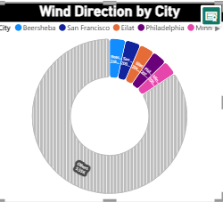
PROBLEM STATEMENT
Create a wind rose chart in Power BI to visualize the prevailing wind directions for a selected city? (Q-13)
EXPLANATION
The above is the rose chart representing us the Wind Direction for the cities. The coloured slices are the cities with the wind direction high as compared to other cities and non-coloured part is other cities.

Slide 27
EDA
PROBLEM
STATEMENTS

Slide 28
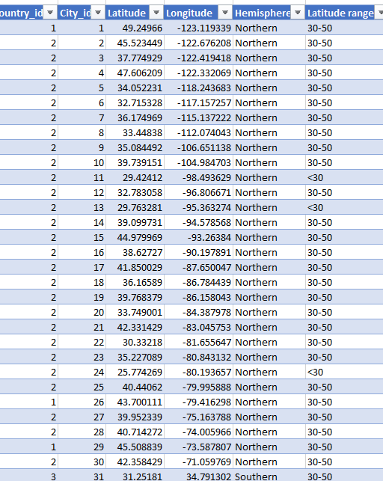
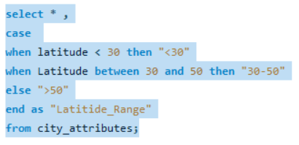
PROBLEM STATMENT
Are there any countries with cities located at extreme latitudes, and how might this impact their climate? (Q-1)
OUTPUT-
SQL QUERY-
EXPLANATION-
Extreme latitudes usually refer to cities located far north or south of the equator. None of the cities in the provided list have extreme latitudes; they are all within the latitudinal range typical for populated areas. Extreme latitudes are usually associated with cities near the poles, which are not present in this list.

Slide 29
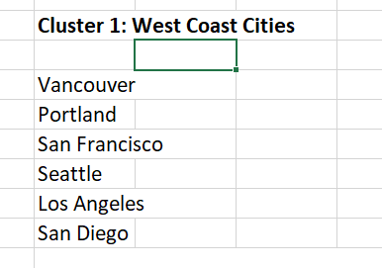
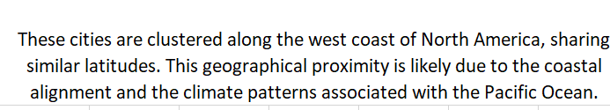
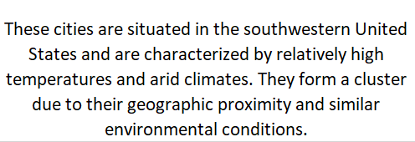
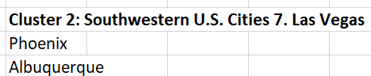
PROBLEM STATMENT
Can you identify any clusters of cities with similar latitude and longitude values? What factors might explain these clusters? (Q-2)

Slide 30
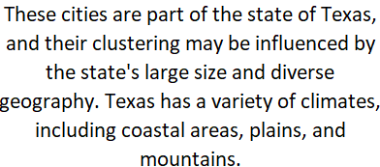
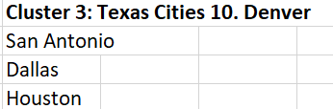
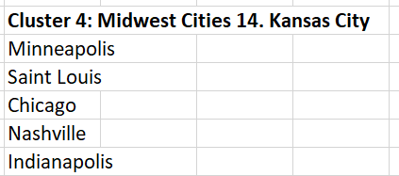
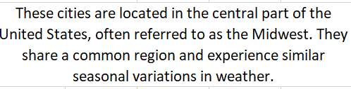
Continuation of Q-2

Slide 31
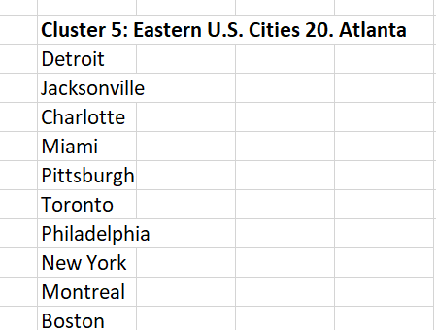
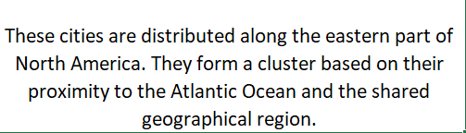
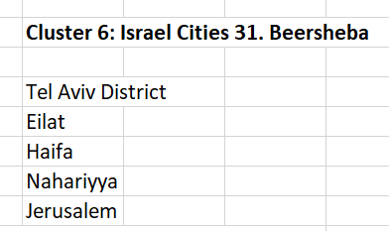
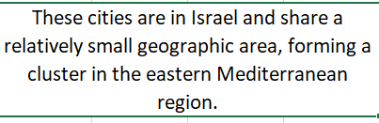
Continuation of Q-2

Slide 32
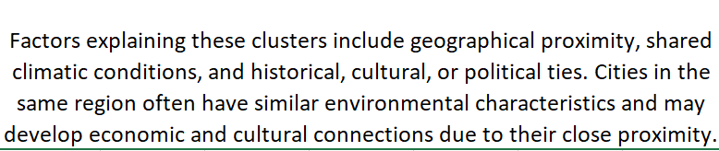
Continuation of Q-2

Slide 33
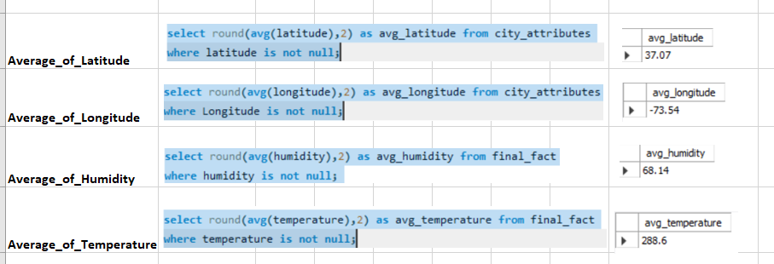
PROBLEM STATMENT
Are there any correlations between a city's geographical location (latitude and longitude) and its weather attributes, such as temperature or humidity? (Q-3)
To find out the correlation we need to find the average of each attribute using SQL
Note- As the Data is huge which can not be pasted in Excel, So Visulisations has been Performed in Power BI

Slide 34
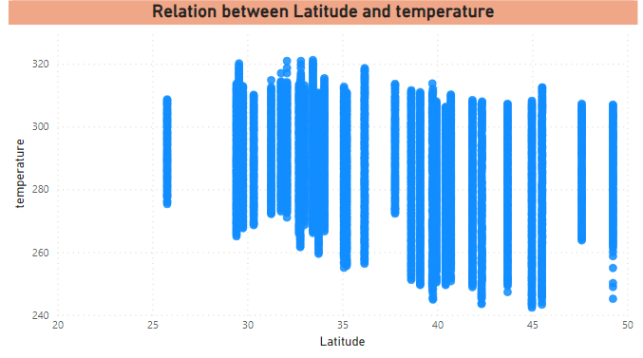
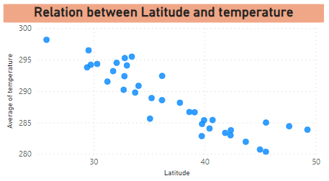
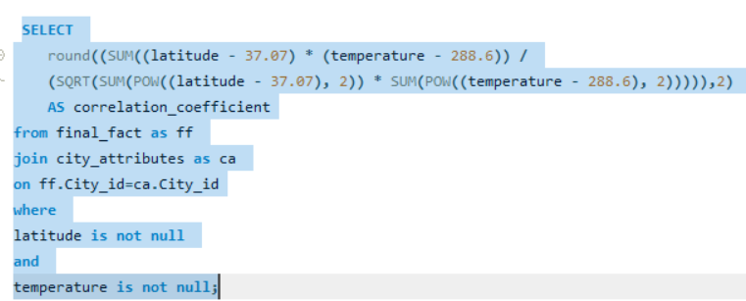
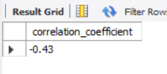
Continuation of Q-3
Correlation between geographical location and weather attributes
VISUAL REPRESENTATION
Correlation between Latitude and Temperature
SQL QUERY
For clear visualisation purpose, I made the y-axis as average.
EXPLANATION
There is negative Correlation between latitude and Temperature which means they do travel in opposite directions. Like, if one increases than other thing will get decreased and vice-versa. The Correlation Coefficient between Latitude and the Temperature is -0.43
OUTPUT

Slide 35
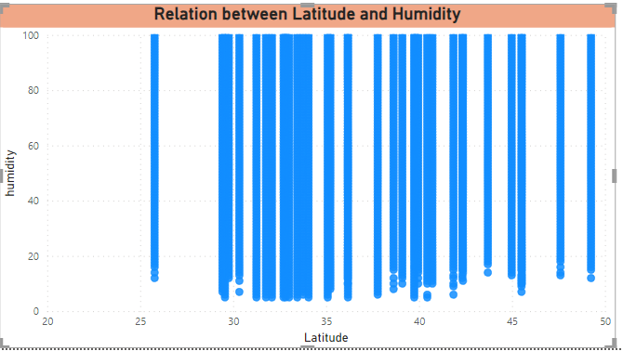
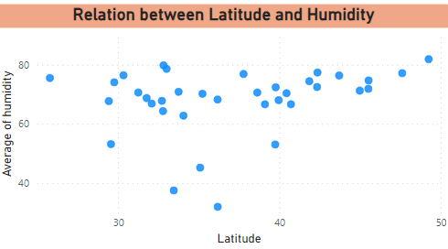
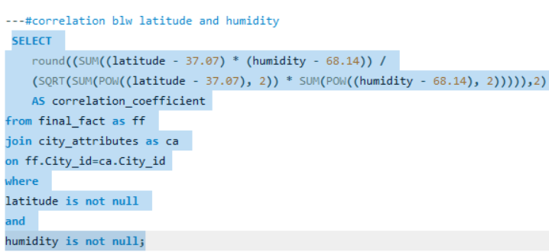

Continuation of Q-3
Correlation between geographical location and weather attributes
VISUAL REPRESENTATION
Correlation between Latitude and Humidity
SQL QUERY
For clear visualisation purpose, I made the y-axis as average.
EXPLANATION
There is Positive Correlation between latitude and Humidity which means they do travel in same directions. Like, if one increases than other thing will get increased and vice-versa. The Correlation Coefficient between Latitude and the Humidity is 0.12
OUTPUT

Slide 36




Continuation of Q-3
Correlation between geographical location and weather attributes
VISUAL REPRESENTATION
Correlation between Longitude and Temperature
SQL QUERY
For clear visualisation purpose, I made the y-axis as average.
EXPLANATION
There is Positive Correlation between Longitude and Temperature which means they do travel in same directions. Like, if one increases than other thing will get increased and vice-versa. The Correlation Coefficient between Longitude and the Temperature is 0.21
OUTPUT

Slide 37



Continuation of Q-3
Correlation between geographical location and weather attributes
VISUAL REPRESENTATION
Correlation between Longitude and Humidity
SQL QUERY
For clear visualisation purpose, I made the y-axis as average.
EXPLANATION
There is Positive Correlation between Longitude and Humidity which means they do travel in same directions. Like, if one increases than other thing will get increased and vice-versa. The Correlation Coefficient between Longitude and the Humidity is 0.07
OUTPUT

Slide 38

PROBLEM STATEMENT
Identify the top three cities with the most frequent occurrence of rainy weather based on weather descriptions. What are the seasonal patterns? (Q-4)
SQL QUERY
VISUAL REPRESENTATION
OUTPUT
EXPLANATION
city | No_of_Occurances (rainy)
Portland | 10994
Vancouver | 10308
Seattle | 9731
The Pie-Chart shows the Top 3 Cities with rainy weather. It shows the percentage of rainy weather in each of the city among all the top3 cities

Slide 39

Continuation of Q-4
To Show the Seasonal Patterns, created a line chart using Power Bi.
VISUAL REPRESENTATION
EXPLANATION
Seasonal Patterns The Seasonal Patterns can be seen as the rain part begins in Quarter 1 and gradually increases to it up to Quarter 3 and fall down in Quarter 4. Every Year the Same Pattern has been Followed

Slide 40




PROBLEM STATEMENT
Is there a correlation between humidity levels and air pressure? How might this relationship affect weather conditions? (Q-5)
SQL QUERY
VISUAL REPRESENTATION
For clear visualisation purpose, I made the y-axis as average.
EXPLANATION
Yes, there is a Correlation Between Humidity and Pressure and it is a Positive Correlation, which means that both the attributes travel towards same direction. If the humidity increases than the pressure will automatically increases and vice-versa.
OUTPUT

Slide 41
Continuation of Q-5
Affect on Weather Conditions
When a low-pressure system moves into an area, it usually leads to cloudiness, wind, and precipitation. High-pressure systems usually lead to fair, calm weather. The higher the humidity the greater the water vapour, and the more rain we're likely to see.

Slide 42

PROBLEM STATEMENT
Explore the impact of wind direction on temperature for coastal cities. Are there noticeable patterns? (Q-6)
Coastal Cities Consideration
Coastal cities in this list include Vancouver, Portland, San Francisco, Seattle, Los Angeles, San Diego, Houston, Miami, Philadelphia, New York, Montreal, Boston, Tel Aviv District, Eilat, Haifa, Nahariyya. Note that some cities, like Las Vegas, Phoenix, and Denver, are inland and not considered coastal.
SQL QUERY

Slide 43

VISUAL REPRESENTATION
Continuation of Q-6
EXPLANATION
As the data is Huge, Performed Visualisation using the Power Bi
The impact of wind direction on temperature for coastal cities can be significant and is influenced by various factors such as maritime influences, land-sea temperature contrasts, and local topography. When it comes to Patterns, I observed that each coastal city has its pattern. but there is common pattern between all coastal cities is that it has been moving like a wave. this can be observed with the help of average line.

Slide 44

PROBLEM STATEMENT
Are there specific months when cities experience significant temperature fluctuations? What might explain these variations? (Q-7)
SQL QUERY

Slide 45

Continuation of Q-7
EXPLANATION
VISUAL REPRESENTATION
Temperature Fluctuations
As the data is Huge, Performed Visualisation using the Power Bi
From the above visual we can clearly say that the temperature at the beginning i.e., January and February has the low temperature and it gradually increases and there was a significant rise in the months of JUNE, JULY, AUGUST,SEPTEMBER and again it slowly decreases and also made a significant change fall down in December.
Variations Explanation
These Variations will explain about the change in temperature over each month of every year. it resembles the seasons climate change.

Slide 46

PROBLEM STATEMENT
Identify periods of extreme weather events, such as storms or heatwaves, by analyzing the time-based data. What patterns emerge? (Q-8)
As there is no things like mentioned as storms or heatwaves in the given data. So, I assume that dragging the values that can be seen similar with the storms. I would like to consider the following. They are 1. Broken_Clouds 2. Scatter Cloud 3. Thunderstorm with Heavy Rain. 4. Heavy Intensity Rain 5. Volcanis ash
SQL QUERY

Slide 47

Continuation of Q-8
EXPLANATION
VISUAL REPRESENTATION
There are Different Patterns for Storms. 1.Mostly, the scattered clouds and broken clouds emerge a very high intensity. For all over the years its been started at a medium space and it gradually increasing in the middle of the year and slowly decreasing at the end of the year. the same pattern has been emerged over every year for Scattered Clouds and Broken Clouds.
2.Coming to the Heavy intensity rain, we can only a rise of it in the year of 2015 and its being constant all over every year.
3.thunderstroam with heavy rain has been on 0 most of the time over every Year.
4. The Volcanic Ash occurred only once in a while, 2013- 1 time, 2015- 1 time, 2017- 1 time as per the given data.
As the data is Huge, Performed Visualisation using the Power Bi

Slide 48

PROBLEM STATEMENT
Are there any notable differences in temperature trends between northern and southern hemisphere cities over the year? How do they relate to seasons? (Q-9)
EXPLANATION
VISUAL REPRESENTATION
As the data is Huge, Performed Visualisation using the Power Bi
Trend Between Hemisphere's
In Northern Hemisphere, has low average of the temperature in the year 2012( December month)
The trend of average temperature has been constant or may be a little rise throughout the Year and it slowing rising each year.
I observed that similar thing is happening in with the southern hemisphere cities as well.
The only difference between the average temperature of southern hemisphere and northern hemisphere is -- Southern Hemisphere has more average temperature as compared to Northern Hemisphere, Which will be resulted in the more temperature in Southern and less temperature in Northern Hemisphere
Relate to Seasons-
This Analysis can be used to relate with the seasons, For Eg- if it comes to Summer Season there might be no such great differences in the average Temperature. When it comes to other seasons we can see there might be differences in the temperature like more avg temperature in Southern Hemisphere cities as compared to Northern Hemisphere Cities.

Slide 49
PROBLEM STATEMENT
What are the consequences of prolonged periods of extreme cold or heat in specific cities? How do residents adapt to such conditions? (Q-10)
EXPLANATION
Generally for this type of Question, the Theoretical answers will justify more.
For the Cities we have in our data based on their Countries, there are extreme heat and Cold places present over there. Consequences for Extreme Heat
heat-related illnesses, stress power grids, and increase water demand. increased risk of wildfires.
Consequences for Extreme Cold
Transportation related issues, Power Outage, Wind chill, limited day light, snow fall.
Adaptions Extreme Cold Snow removal equipment’s, heating systems, layered clothing, restricted outdoor activity. Extreme Heat
Extensive use of AC, Hydration Measures, water saving technologies, awareness campaigns.

Slide 50


PROBLEM STATEMENT
Investigate whether temperature anomalies (unusual deviations from the norm) coincide with certain events or environmental factors in specific cities? (Q-11)
SQL QUERY
OUTPUT

Slide 51

PROBLEM STATEMENT
Analyse the impact of temperature on energy consumption patterns in cities. Are there noticeable trends or correlations? (Q-12)
VISUAL REPRESENTATION
EXPLANATION
There is no such data related to energy consumption in cities. So, just finding the temperature trends over time.
I observe there is a wave like pattern been following every year.
Generally, there is a positive correlation between temperature and energy consumptions. We estimate 1 degree increase in temperature will drive up to electricity demand in region by 6.7%.

Slide 52

PROBLEM STATEMENT
How do specific wind patterns impact air quality and pollution dispersion in urban areas? Analyze wind direction data for insights? (Q-13)
To Analyse this particular Problem we need to have the data regarding air quality and air pollution dispersion in the cities. But, as of now we don’t have the data regarding that. If the required data is available we would have made a meaningful insights.
VISUAL REPRESENTATION
EXPLANATION
From the given problem, I tried make analysis of the wind_direction by Year. It shows that the wind directions has been increasing year by year, which can be resulted in the air pollution and dispersion in the cities.

Slide 53

PROBLEM STATEMENT
Identify cities prone to strong winds and the potential consequences, such as increased risk of natural disasters or challenges for transportation? (Q-14)
The Statement is to find the cities with strong winds that can cause and increase in natural disasters and also which will cause the challenges for transportation. So, as per my understanding there is no direct data related to it. I would like to assume as the following conditions will be act as near synonyms. MIST, THUNDERSTROM, DUST, SLEET, DRIZZLE, SQUALLS, TORNADO, OVERCAST CLOUDS
SQL QUERY

Slide 54

Continuation of Q-14
VISUAL REPRESENTATION
As the data is huge, performed the visualisation using Power Bi
EXPLANATION
The Cities which have high chances of prone to strong winds and the potential consequences, such as increased risk of natural disasters or challenges for transportation are listed above.

Slide 55

PROBLEM STATEMENT
Explore whether wind speed and direction influence the frequency and severity of weather-related events (e.g., hurricanes, storms) in coastal cities? (Q-15)
As there is no direct word as Hurricanes or stroms in the data, I would like to consider the Following as Synonms for them. 1.Broken Clouds, 2. Scattered Clouds, 3.Ragged thunderstorm 4.Squalls 5.Tornado.
SQL QUERY

Slide 56

Continuation of Q-15
VISUAL REPRESENTATION
As the data is huge, performed the visualisation using Power Bi
EXPLANATION
From the Visual I understood that The severity of weather related events can be impacted by wind direction and wind Speed in Coastal cities. Usually, the Coastal Cities or areas has more severity because they located on the interface of the land and sea, inluced large inland areas. so, it can be clearly understandable if the wind speed or wind direction increased, the severity of the weather_events related to Hurricanes and Storms will rise a well.

Slide 57


